Slide 1
Forecasting Fine-Grained Air Quality Based on Big Data
Date: 2015/10/15
Author: Yu Zheng, Xiuwen Yi, Ming Li1, Ruiyuan Li1, Zhangqing Shan, Eric Chang, Tianrui Li
Source: KDD '15
Advisor: Jia-ling Koh
Spearker: LIN,CI-JIE

Slide 2
Outline
Introduction
Method
Experiment
Conclusion

Slide 3
Introduction
People are increasingly concerned with air pollution, which impacts human health and sustainable development around the world
There is a rising demand for the prediction of future air quality, which can inform people’s decision making

Slide 4
Challenges
Multiple complex factors vs. insufficient and inaccurate data
Urban air changes over location and time significantly
Inflection points and sudden changes

Slide 5
Introduction
Goal: construct a real-time air quality forecasting system that uses data-driven models to predict fine-grained air quality over the following 48 hours(first 6, 7-12, 12-24, and 24-48 hours)

Slide 6
Outline
Introduction
Method
Experiment
Conclusion

Slide 7
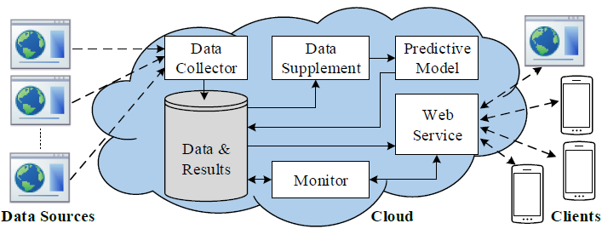
Architecture of our system

Slide 8
Framework

Slide 9
Framework

Slide 10
Temporal Predictor (TP)
Considering the prediction more from its own historical and future conditions (local)
A linear regression is employed to model the local change of air quality
Train a model respectively for each hour in the next six hours, and two models for each time interval (from 7 to 48 hours) to predict its maximum and minimum values

Slide 11
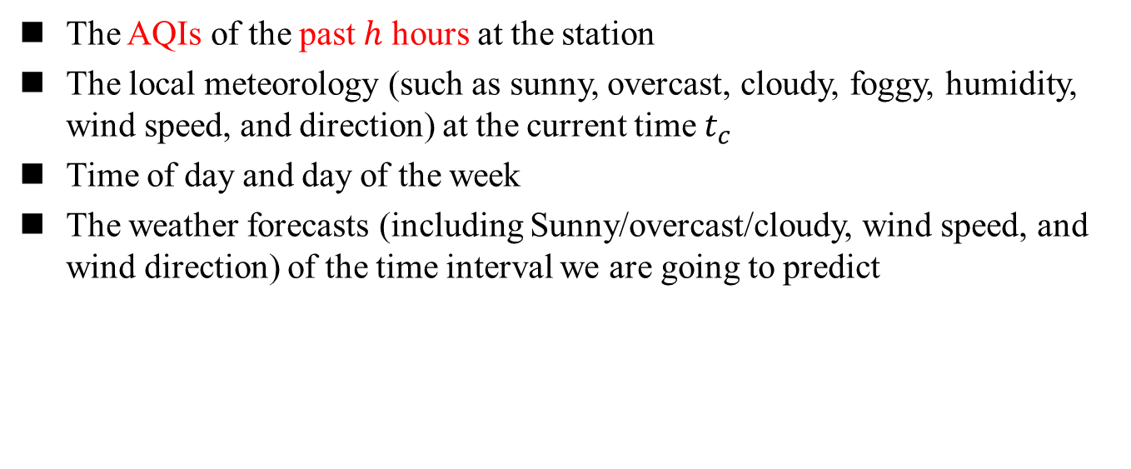
Features
The AQIs of the past ℎ hours at the station
The local meteorology (such as sunny, overcast, cloudy, foggy, humidity, wind speed, and direction) at the current time $t_{c}$
Time of day and day of the week
The weather forecasts (including Sunny/overcast/cloudy, wind speed, and wind direction) of the time interval we are going to predict

Slide 12
Framework

Slide 13
Spatial Predictor (SP)
Modeling the spatial correlation of air pollution
Predicting the air quality from other locations’ status consisting of AQIs and meteorological data
Train multiple spatial predictors corresponding to different future time intervals
Two major steps:
  Spatial partition and aggregation
  Prediction based on a Neural Network

Slide 14
Spatial partition and aggregation
Partition the spatial space into regions by using three circles with different diameters
Calculate the average AQI for a given kind of air pollutant; same for temperature and humidity
Each region will only have one set of aggregated air quality readings and meteorology

Slide 15
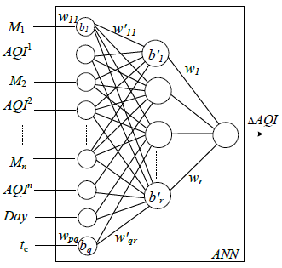

Spatial Predictor
Features of SP
  the AQI of the past three hours (${AQI}^{i}$)
  meteorological features ($M^{i}$), including the wind speed and direction, of the current time $t_{c}$.

Slide 16
Framework

Slide 17
Prediction Aggregator(PA)
The prediction aggregator dynamically integrates the predictions that the spatial and temporal predictors have made for a location
Feature Set
  wind speed, direction, humidity, sunny, cloudy, overcast, and foggy
  the predictions generated by the spatial and temporal predictors
  the corresponding Δ𝐴𝑄𝐼 (from the ground truth)
Train a Regression Tree (RT) to model the dynamic combination of these factors and predictions

Slide 18
Prediction Aggregator(PA)

Slide 19
Framework

Slide 20
Inflection Predictor
The air quality of a location changes sharply in a few hours
Too infrequent to be predicted
Invoke to handle sudden changes
  Need to know when to invoke the IP model

Slide 21

Inflection Predictor
Select the sudden drop instances $D_{i }$from historical data 𝐷
  AQI is bigger than 200 and decreases over a threshold in the next few hours
Find surpassing ranges and categories

Slide 22
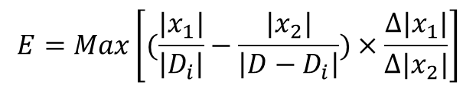
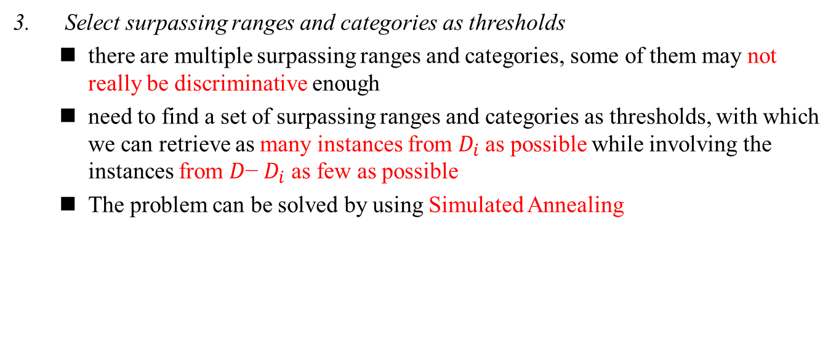


Inflection Predictor (IP)
  Select surpassing ranges and categories as thresholds
  there are multiple surpassing ranges and categories, some of them may not really be discriminative enough
  need to find a set of surpassing ranges and categories as thresholds, with which we can retrieve as many instances from $D_{i}$as possible while involving the instances from 𝐷− $D_{i}$ as few as possible
  The problem can be solved by using Simulated Annealing
$$x_{2}$$
$$\left.E=\underset{}{Max}\left[(\frac{{|x}_{1}|}{\left|D_{i}\right|}−\frac{{|x}_{2}|}{\left|D−D_{i}\right|}\right.)×\frac{∆{|x}_{1}|}{∆|x_{2}|}\right]$$
$$x_{1}$$
${D_{t}=x}_{1}∪x_{2}$ is a collection of instances retrieved by a set of surpassing ranges and categories

Slide 23
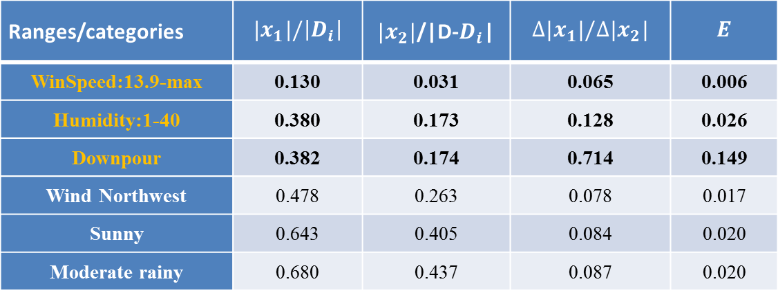
Inflection Predictor (IP)
Ranges/categories | $${|x}_{1}|/\left|D_{i}\right|$$ | ${|x}_{2}|$/|D-$D_{i}$| | $$∆{|x}_{1}|/∆{|x}_{2}|$$ | $$E$$
WinSpeed:13.9-max | 0.130 | 0.031 | 0.065 | 0.006
Humidity:1-40 | 0.380 | 0.173 | 0.128 | 0.026
Downpour | 0.382 | 0.174 | 0.714 | 0.149
Wind Northwest | 0.478 | 0.263 | 0.078 | 0.017
Sunny | 0.643 | 0.405 | 0.084 | 0.020
Moderate rainy | 0.680 | 0.437 | 0.087 | 0.020
Notes:
WinSpeed:13.9-max or Humidity:1-40 or Downpour

Slide 24
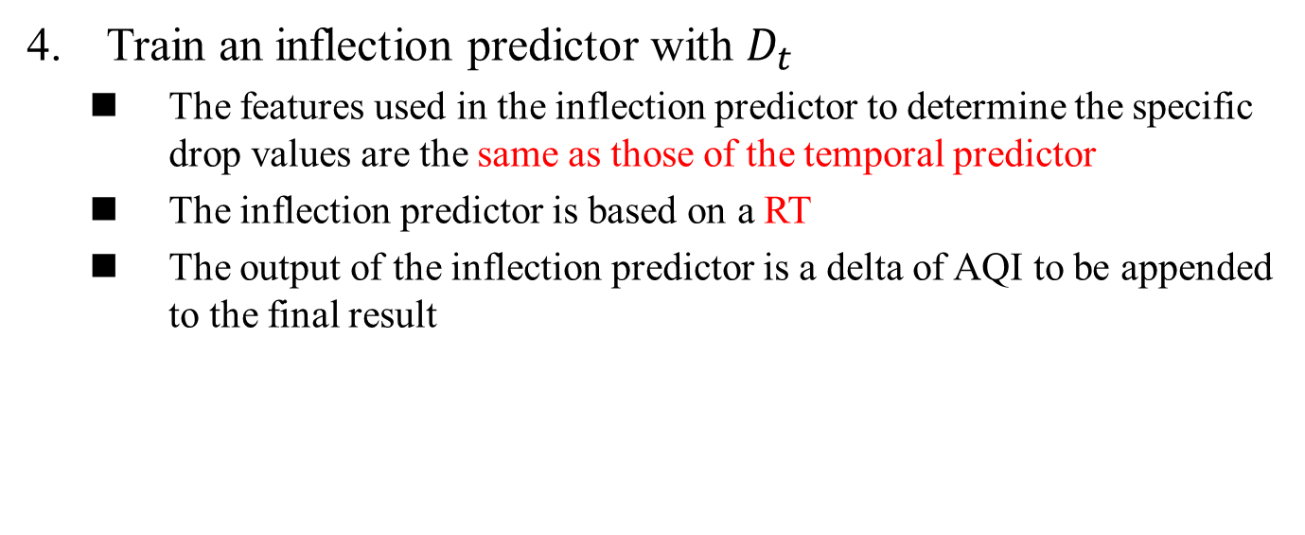
Inflection Predictor (IP)
Train an inflection predictor with $D_{t}$
  The features used in the inflection predictor to determine the specific drop values are the same as those of the temporal predictor
  The inflection predictor is based on a RT
  The output of the inflection predictor is a delta of AQI to be appended to the final result

Slide 25
Outline
Introduction
Method
Experiment
Conclusion

Slide 26
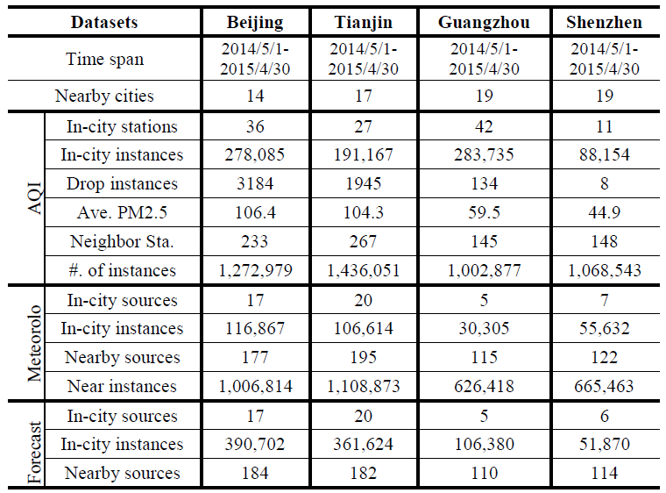
Datasets

Slide 27
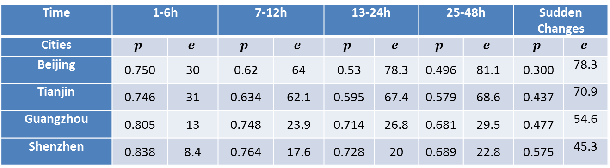
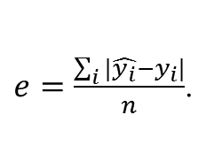
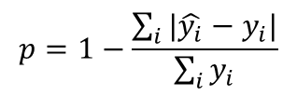
Results
Time | 1-6h |  | 7-12h |  | 13-24h |  | 25-48h |  | Sudden Changes
Cities | $$p$$ | $$e$$ | $$p$$ | $$e$$ | $$p$$ | $$e$$ | $$p$$ | $$e$$ | $$p$$ | $$e$$
Beijing | 0.750 | 30 | 0.62 | 64 | 0.53 | 78.3 | 0.496 | 81.1 | 0.300 | 78.3
Tianjin | 0.746 | 31 | 0.634 | 62.1 | 0.595 | 67.4 | 0.579 | 68.6 | 0.437 | 70.9
Guangzhou | 0.805 | 13 | 0.748 | 23.9 | 0.714 | 26.8 | 0.681 | 29.5 | 0.477 | 54.6
Shenzhen | 0.838 | 8.4 | 0.764 | 17.6 | 0.728 | 20 | 0.689 | 22.8 | 0.575 | 45.3
$$p=1−\frac{\sum_{i}{|\hat{y_{i}}−y_{i}|}}{\sum_{i}{y_{i}}}$$
$e=\frac{\sum_{i}{|\hat{y_{i}}−y_{i}|}}{n}$.

Slide 28
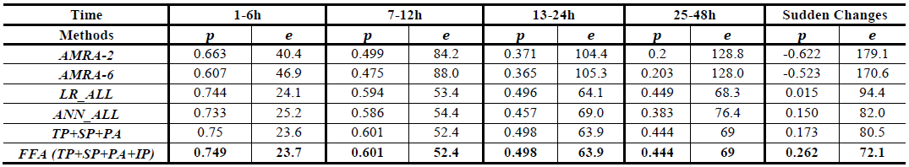
Results

Slide 29
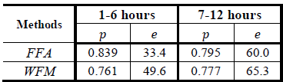
Results

Slide 30
Outline
Introduction
Method
Experiment
Conclusion

Slide 31
Conclusion
Report on a real-time air quality forecasting system that uses data-driven models to predict fine-grained air quality over the following 48 hours
It can achieve an accuracy of 0.75 for the first 6 hours and 0.6 for the next 7-12 hours in Beijing
It predicts the sudden changes of air quality much better than baseline methods

Slide 32
Thanks for listening

